Slide 1

A MINI PROJECT PRESENTATION ON “Library Management System” Submitted By Name : Miss. Akansha Vijay Anpat (02)
Miss. Aditi Ashok Biramane (09) Miss. Siddhi Sunil Chavan (13) Under the Guidance of Prof. P. A. Patel Bharati Vidyapeeth’s College of Engineering, Navi Mumbai Department of Information Technology 2020-2021

Slide 2
LIBRARY MANAGEMENT SYSTEM

Slide 3
Contents
Abstract
Introduction
Need of Work
Advantages of work
System Architecture
Java Feature used
Hardware and Software Requirements
Results
Conclusion
References

Slide 4
ABSTRACT
The Library Management System is an application for assisting a librarian in managing a book library in a university. The system would provide basic set of features to add/update members, add/update books, and manage check in specifications for the systems based on the client’s statement of need.
Library management system is a typical management Information system (MIS), its Development include the establishment and maintenance of back-end database and front-end application development aspects. For the former require the establishment of data consistency and integrity of the strong data security and good libraries. As for the latter requires the application fully functional, easy to use and so on.

Slide 5
INTRODUCTION
Library Management software for monitoring and controlling the transactions in a library .The project “Library Management System” is developed in java, which mainly focuses on basic operations in a library like adding new books, and updating new information, searching books and members and return books.
This project of “LIBRARY MANAGEMENT” of gives us the complete information about the library. We can enter the record of new books and retrieve the details of books available in the library. We can issue the books to the students and maintain their records and can also check how many books are issued and stock available in the library. In this project we can maintain the late fine of students who returns the issued books after the due date.
Throughout the project the focus has been on presenting information and comments in an easy and intelligible manner. The project is very useful for those who want to know about Library Management System.

Slide 6
NEED OF WORK
A Library management system is a software that uses to maintain the record of the library.
It contains work like the number of available books in the library, the number of books are issued or returning or renewing a book or late fine charge record, etc.
Library Management Systems is software that helps to maintain a database that is useful to enter new books & record books borrowed by the members, with the respective submission dates. Moreover, it also reduces the manual record burden of the librarian.
Library management system allows the librarian to maintain library resources in a more operative manner that will help to save their time. It is also convenient for the librarian to manage the process of books allotting and making payment.
Library management system is also useful for students as well as a librarian to keep the constant track of the availability of all books in a store.

Slide 7
IMPORTANCE
A library management system is the most proficient and easy to use system for managing all the processes involved in a Library in the most effective ways.
This system will reduce all the manual work and the whole process can be
managed just through single clicks and edits.
There will be no headache and doubtfulness of storing the data securely
and searching the records of any individual afterward.
Any book seeker can rent a book just by signing in with their details, and
return it with the date of returning.
The staff can also facilitate themselves with some extra authorizations
and privileges
Only, one person is required to take care of the whole system, without any
chances of mistakes.

Slide 8
ADVANTAGES
1 . It reduces the manual paperwork through it and gives proper information of books has been recorded automatically.
2 . Librarian can update the information of books and manage availability and arriver record of the books.
3 . It saves human efforts and time.
4 .With the help of library management software, the customer can easily search and find the books.

Slide 9
ARCHITECHTURE DIAGRAM FOR LIABRARY MANAGEMENT SYSTEM

Slide 10
Library system
Login
Renew book
Search for book
Check out book
Reserve book
Library patron
Check account
librarian
Add book
Return book

Slide 11
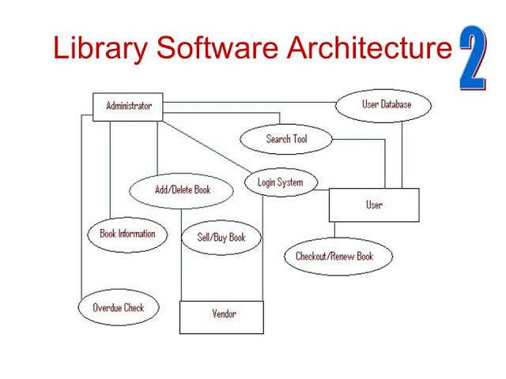

Slide 12
JAVA FEATURES USED
Basic java language
IDE:Intellij
The java platform: std Edition jdk1.8_261 from oracle

Slide 13
HARDWARE & SOFTWARE USED
Hardware Requirements:
Processor: Minimum 1 GHz; Recommended 2GHz or more.
Ethernet connection (LAN) OR a wireless adapter (Wi-Fi)
Hard Drive: Minimum 32 GB; Recommended 64 GB or more.
Memory (RAM): Minimum 1 GB; Recommended 4 GB or above
Software requirements:
IDE:Intellij
The java platform: std Edition jdk1.8_261 from oracle

Slide 14
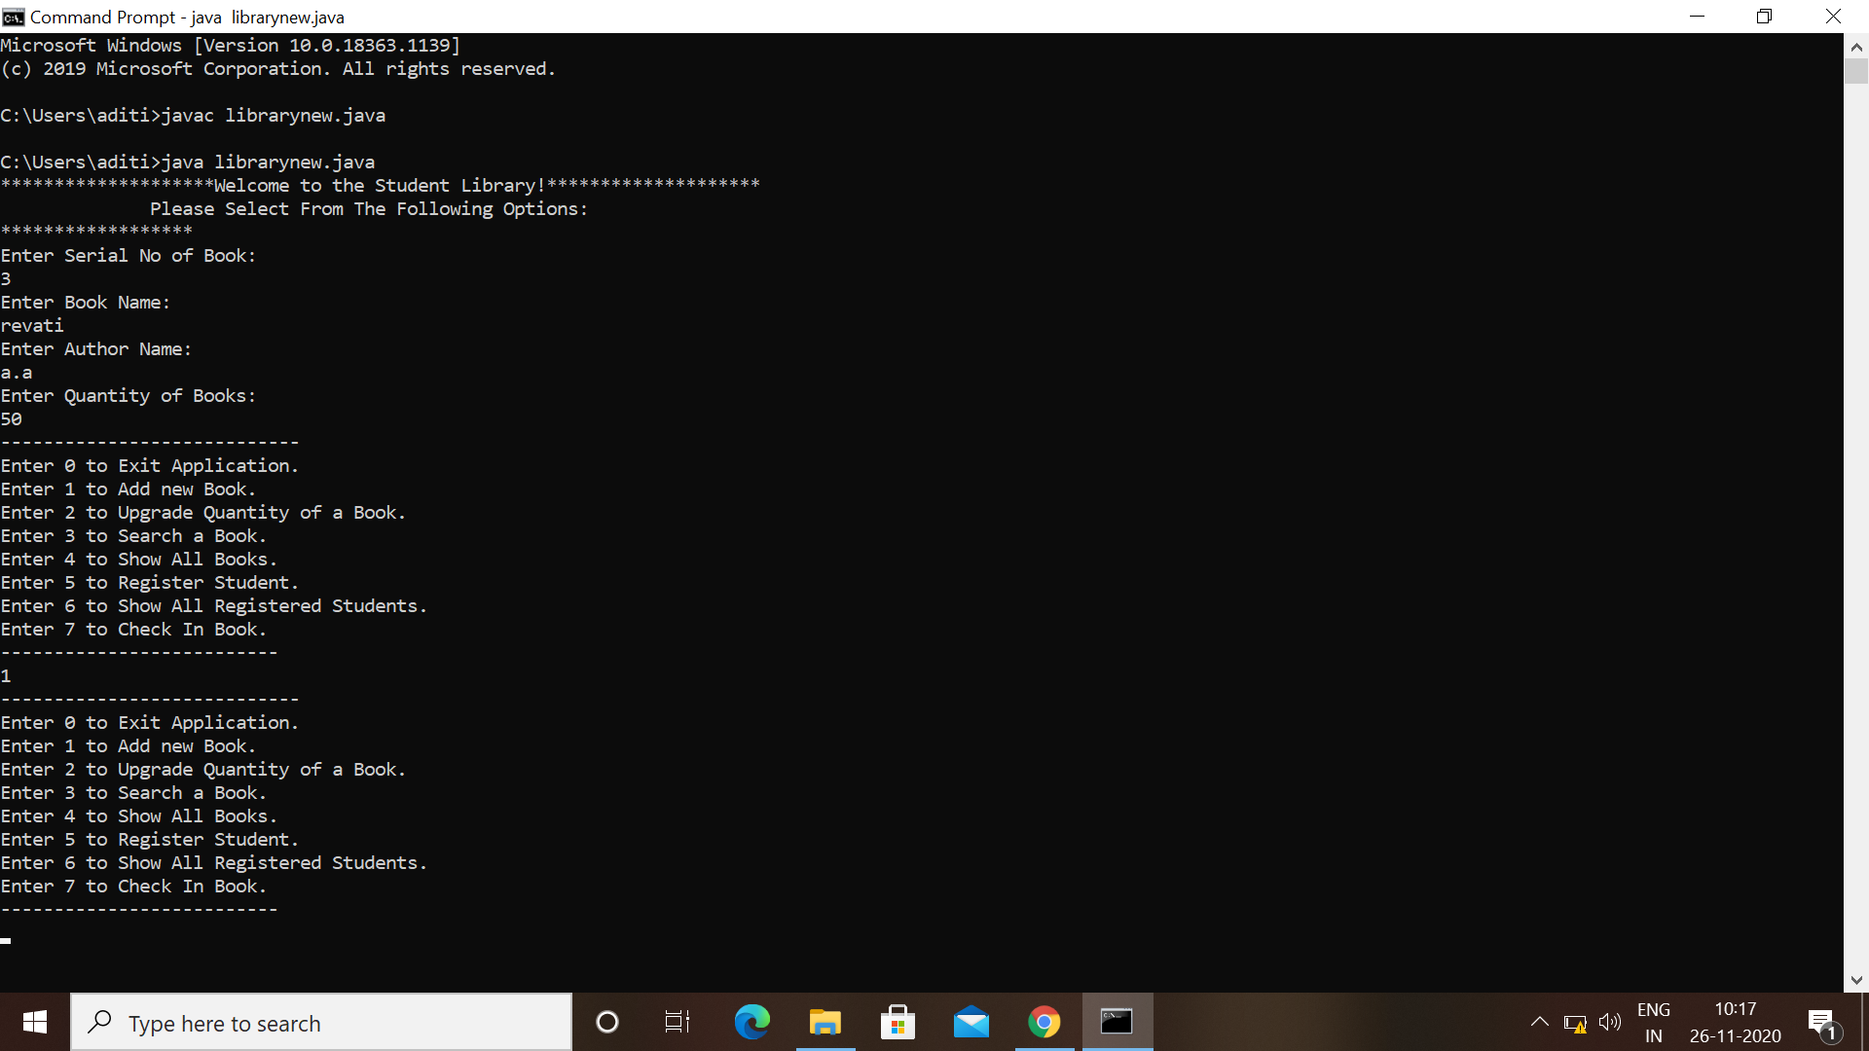

Slide 15
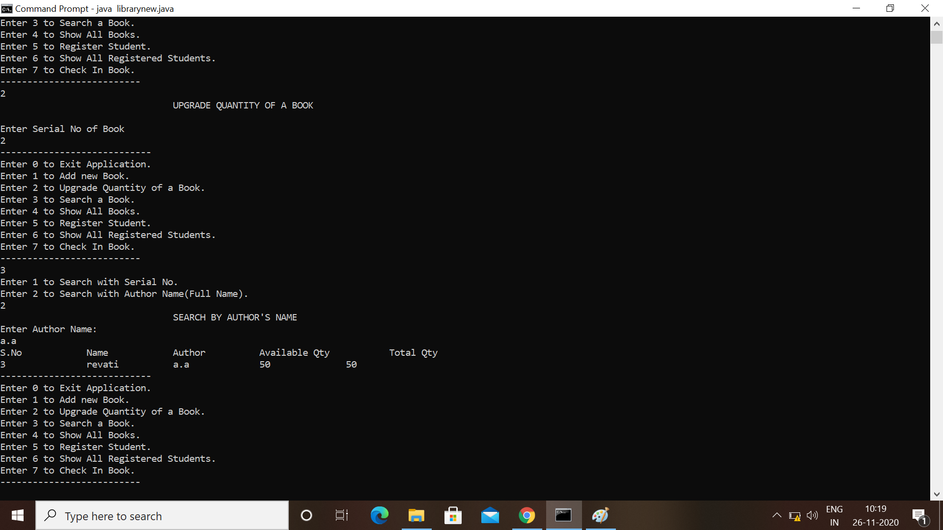

Slide 16
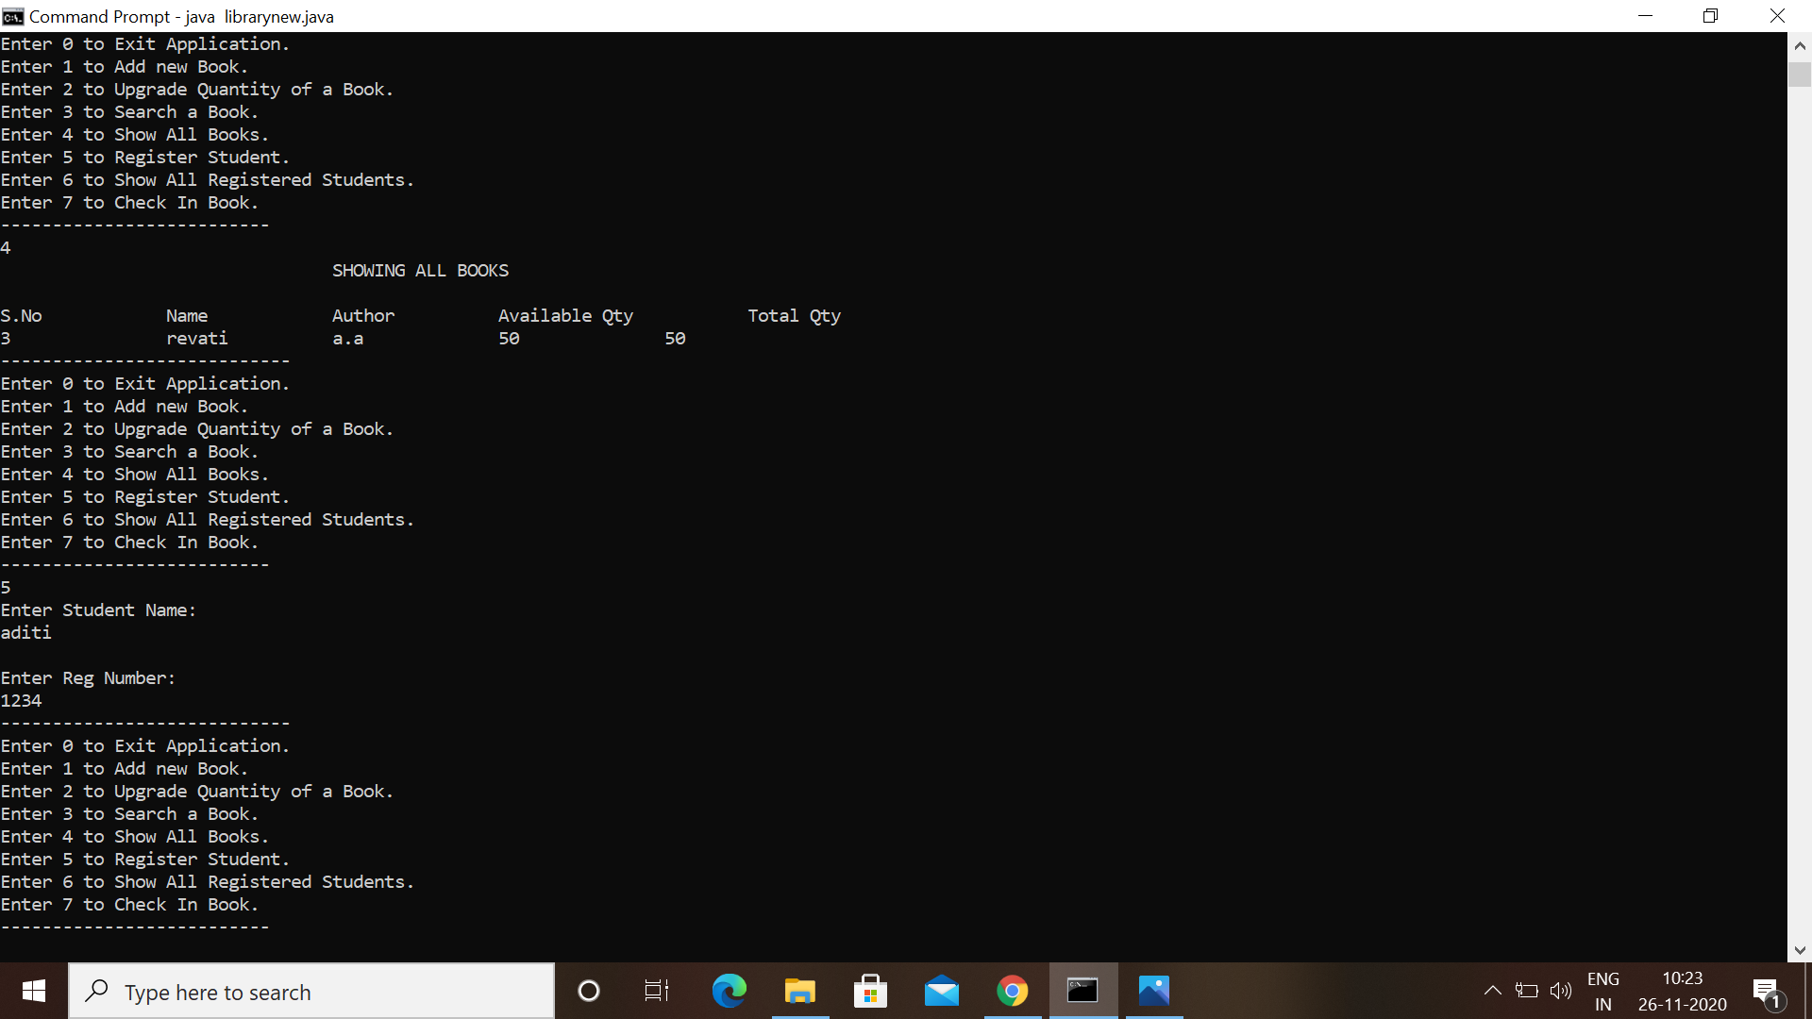

Slide 17


Slide 18
RESULTS
IT IS USEFUL FOR LIABRARIAN AS WELL AS STUDENT
IT IS TIME SAVING
IT IS VERY EASY TO USE
IT WILL KEEP ALL THE RECORDS

Slide 19
CONCLUSION
This was an effort to develop a simple Library Management System which may be useful in a Library to insert ,store, handle and retrieve information about books etc.

Slide 20
REFERENCES :
Java Complete Referances by Herbert Shield
Wikipedia, URL: http://www.wikipedia.org.
Google, URL: http://www.google.co.in
GEEKS FOR GEEKS JAVA

Slide 21
Thank you

